Slide 1
Building Stronger Scouting
Serving today’s volunteers and Scouting families
Three Fires Council
Boy Scouts of America
District Re-structuring 2019
Notes:
Narrative
Hello, My name is Jeff Gross. I am a 28 year scouting volunteer having served as an Asst Cubmaster, a Scoutmaster, many District roles and currently serving as your Vice Chair of District Operations for the Three Fires Council. This presentation will tell you the Why, What and a bit of the How our Scouting Districts are restructuring. Let’s get started.
Jeff Gross
Introduce presenters
Thank everyone for coming
Brief review of agenda and instructions for Q &A
Index cards

Slide 2
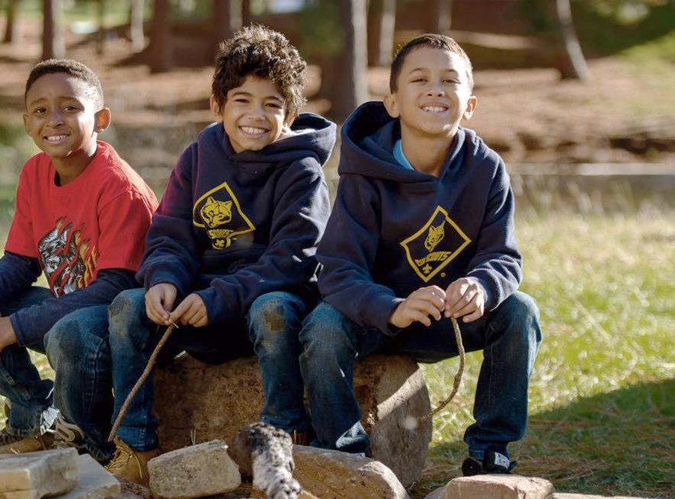
WHY CHANGE?
Changing workforce:
DE’s asked to manage more tasks over last 20 years
Trained to specialize
Team based= greater potential retention
Changing families: less free time
More two-income families than ever before
More single-parent head-of-households than ever before
More blended families than ever before
Notes:
Narrative:
The professional District Executive position has become more demanding in the last 20 years. This increased workload due to more job responsibilities and less volunteer involvement has stretched the workforce to a point in which we cannot keep DE’s for a sufficient and efficient timeframe. This staff turnover is costly from an on-boarding aspect and does not allow volunteer relationships to flourish either.
Jay Herzog
As a result today’s families have less “free time”.
Family Scouting helps address this issue but we most also address how the local council supports volunteers who deliver Scouting week in and week out.
The BSA has not adopted strategies for the internet/google generation or for a workforce that is trained more and more to specialize vs. generalize.
BSA staff is asked to do more and more which leads to higher turnover and lost relationships and lost succession planning and then more placed on volunteers to fill in the gaps.

Slide 3
How did we get here?
Strategic plan action item from 2015
First Task-force; District Ops Committee and ACCs’ (Aug. 2018)
Second taskforce members of various District Key3’s (Oct. 2018)
Council Key 3 meeting (Nov.. 2018)
3rd Task force District Committee, Council Committee and Commissioners (Jan-Mar. 2019)
Council Coordinated Meeting (Jan. 2019)
Notes:
Narrative:
This organization change was recognized in the strategic plan 3 years ago, in the last half of 2018, designed with volunteer involvement and a full announcement of the change was made in January 2019.
Jay-
1st task force- charter do we need to do something different? What a re other councils doing
2nd task force what should we do?
3rd task force- work out details and implementation plan

Slide 4
Reducing the number of Districts from ten to three.
Each District will have a team of professionals assigned.
The team approach will allow the District Committee/Commissioners and unit volunteers to receive support from the rest of the team when a staff vacancy occurs.
What’s Changing?
.
Notes:
Narrative:
We are reducing the number of Districts to 3 while keeping the same number of professional staff, thus allowing them to work in a team environment with role specialization. The benefits of this approach is that the staff can specialize in Membership, Development or Activities amongst other areas too. This change will allow staff to have more progression opportunity within the same district allowing them to have longer relationships with volunteers. Also, the volunteers will have coverage if one of the staff does decide to leave with other staff being able to temporarily fulfill that role.
Clint Scharff
The team approach also fits better with today’s workforce which is more collaborative and allows individual team members to focus on specific tasks.
Better staff retention will lead to better volunteer retention, and succession planning and better unit level volunteer support

Slide 5
Staffing Changes
Potawatomi District
(Kishwaukee & Maramech Hill)
Two District Executives (FT) and a Field Director (PT).
Ottawa District
(Great Bear, Fox Valley, Foxfire)
Three District Executives (FT) and a Field Director (PT).
Chippewa District
(Northern Trail, Pottawaomie Trail , Chanonee,
Thunderbird & Indian Prairie)
Six full time District Executives assigned.
Notes:
Narrative:
Potawatomi District made up of the former ( Kishwaukee & Maramech Hill districts) will have two District Executives and a Field Director. The Field Director will be team lead and will lead Community Development efforts in the District. One DE will take lead on Advancement and Training Committee support, the other on Camping & Training support, they both will support Membership and unit service efforts
Ottawa Dist. (Great Bear, Fox Valley, Foxfire) Will have three District Executives; District Director Team lead responsible for community development, and District leadership development and strategic partnerships. DE-Program responsible for supporting the program Committee and product sales, DE- Unit Service responsible for Membership, Commissioner and Family -FOS.
Chippewa Dist. (NT, PT, Channonee, Thunderbird & Indian Prairie)
Will have six full time staff assigned. The Field Director will be team lead and drive Community development, committee development and strategic partnerships, District Director-Unit Service and 2 DE’s Unit Service will be responsible for Membership, Commissioner Service and Family FOS the other 3 DE’s will support the Program Committee and product sales.
Clint Scharff

Slide 6
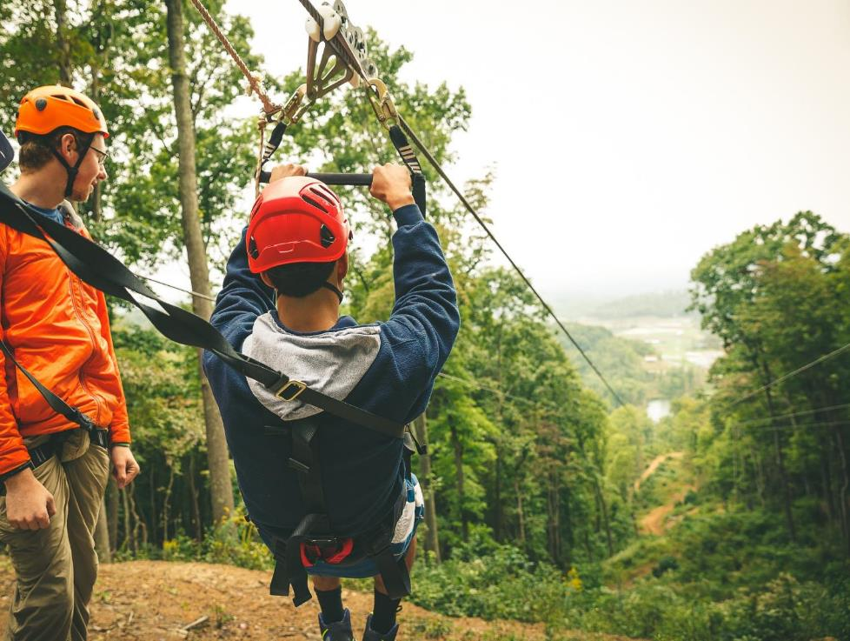
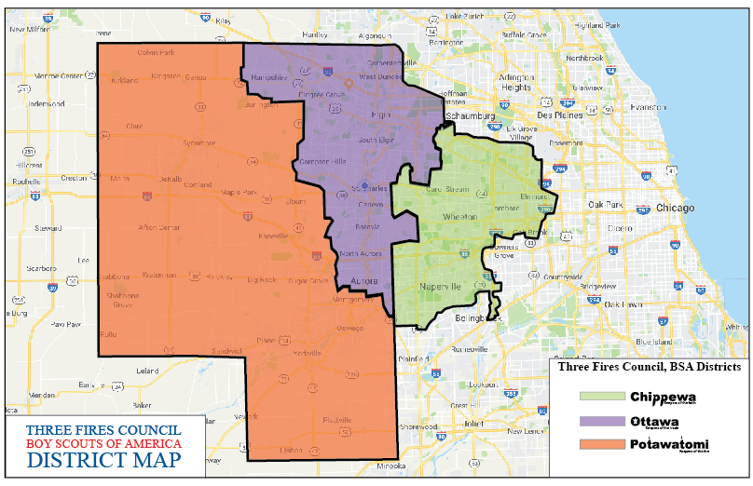
Notes:
Narrative:
This is a map of the of how the districts now look. The most dense population wise is Chippewa with Ottawa being in the middle and Potawatomi having the most farmland.
Clint
Review trifold brochure

Slide 7
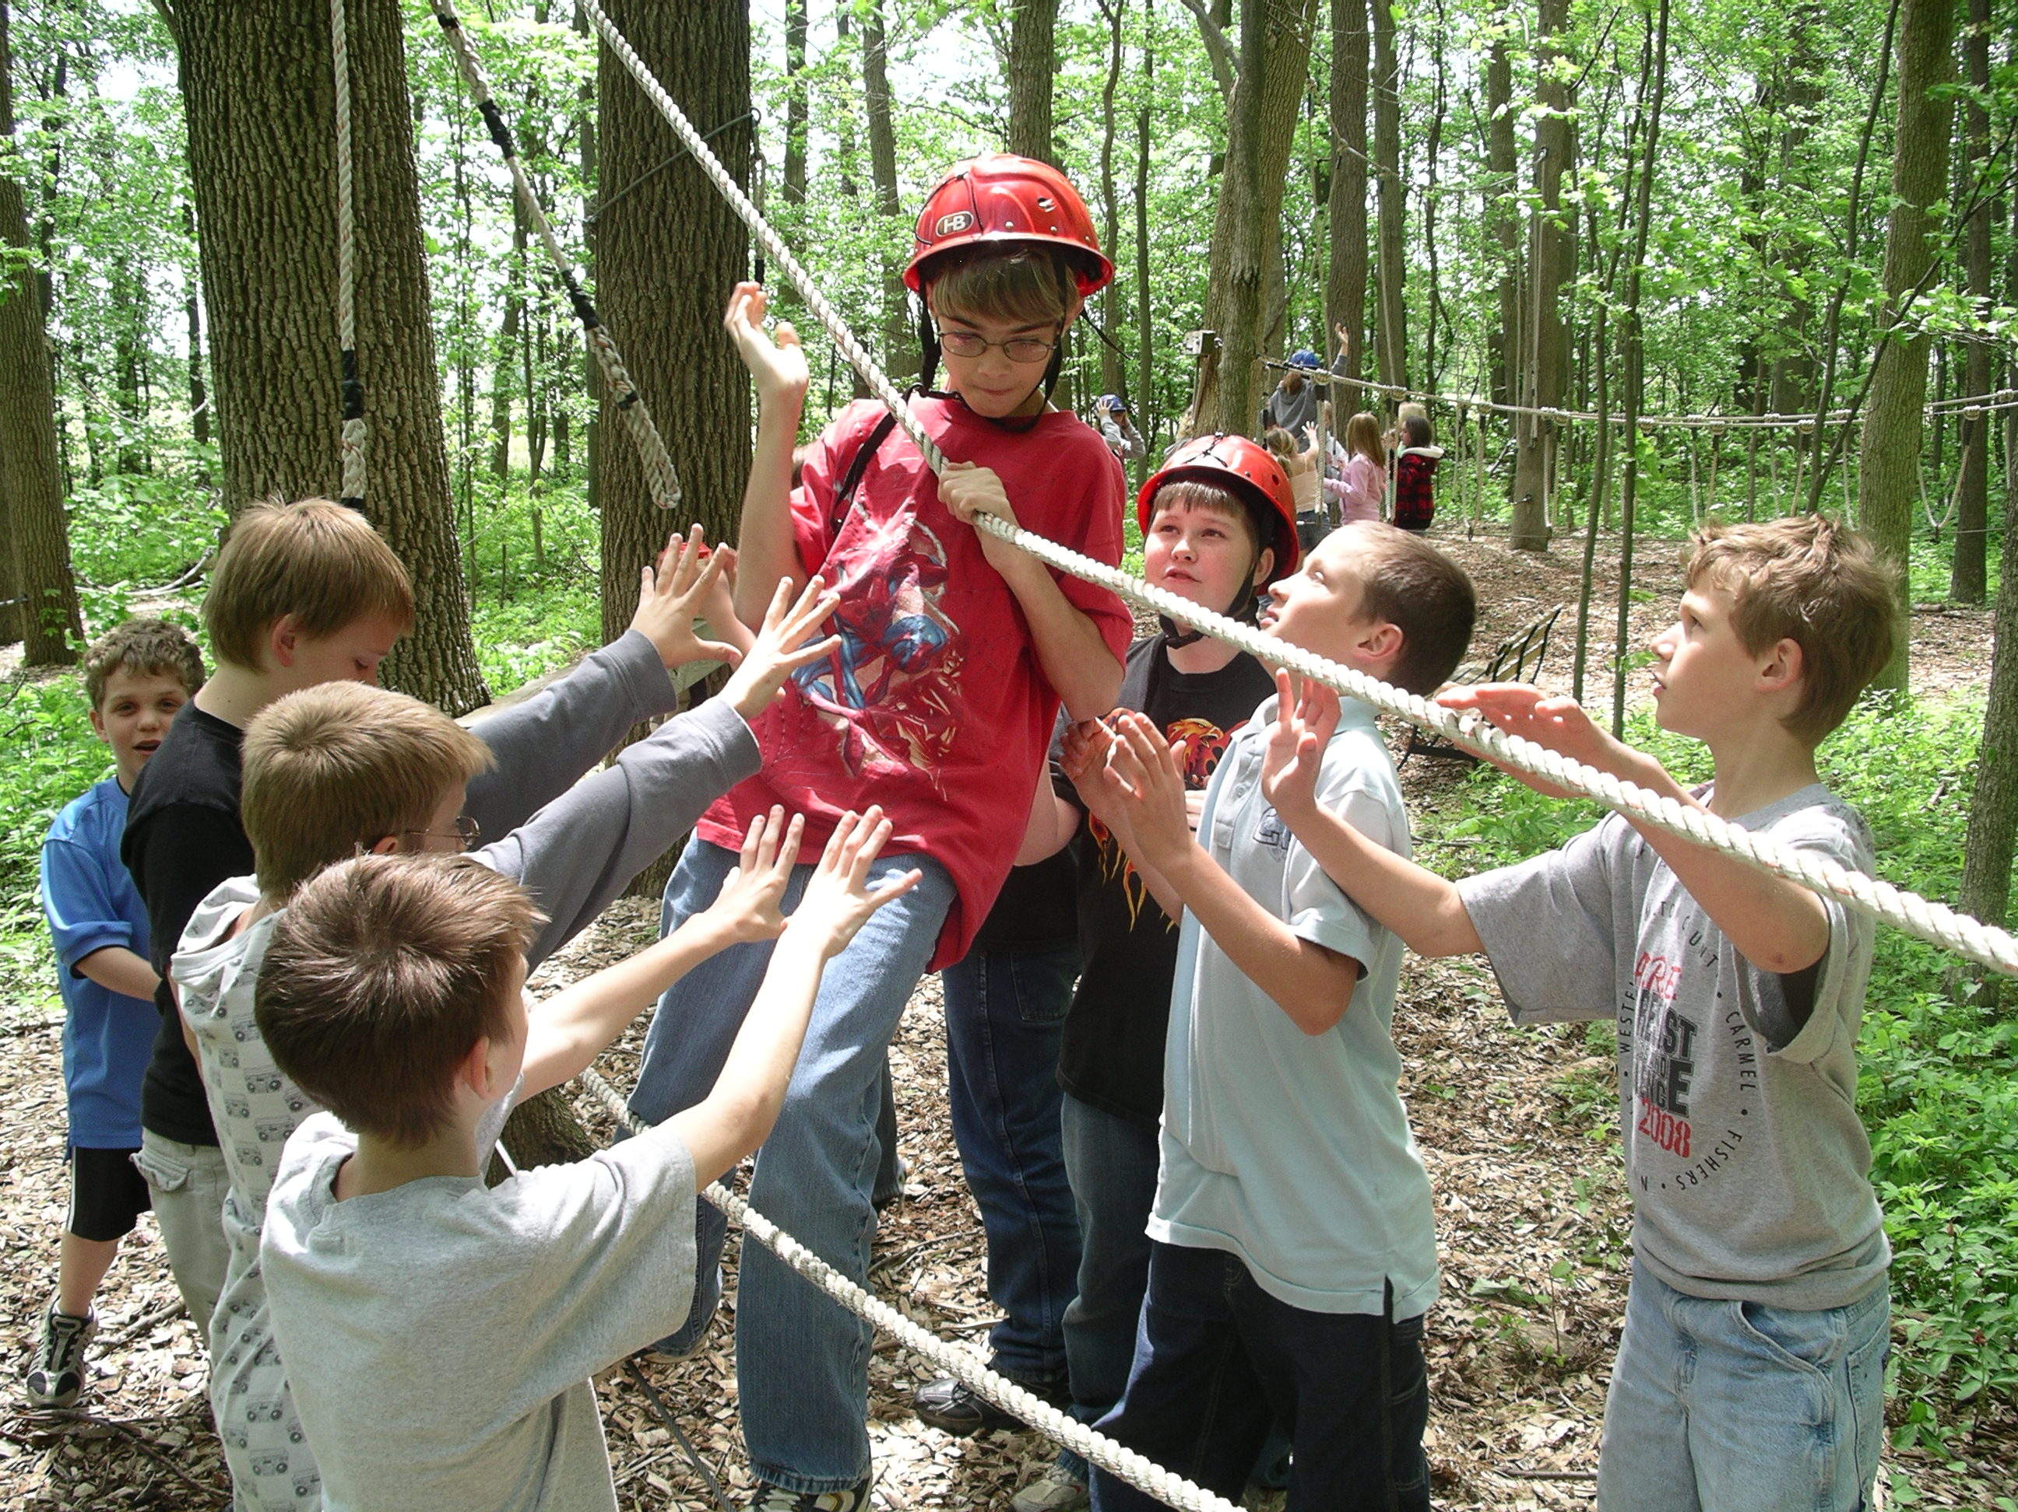
Volunteer Changes
By consolidating Districts we plan to have fewer “chairs” and more committee members.
The District Chair
The District Commissioner
District Vice Chairs
Notes:
Narrative:
By Consolidating Districts we plan to have fewer “chairs” and more committee members.
The District Chair will lead a smaller District Leadership team of 4 or so Vice-Chairs in Membership, Program, Development and Marketing with possibly some more focused VC’s too.
District Vice Chairs will recruit and lead the various subcommittees of the district to support unit operations, each new district is expected to keep the former district teams in place as to not disrupt all the good work being done. For example Chippewa District may have five Eagle Board chairs to support each former district. Potawatomi may have only two or three Asst. Dist. Commissioners to recruit a full team of Unit Commissioners members.
The District Commissioner will lead a team of Asst. Dist. Commissions which aligns with the former boundaries. They will continue to work with and recruit Unit Commissioners and also coordinate with the District Leadership team on the program and delivery of the monthly Leader’s Forum which is the Roundtable replacement.
Our current volunteers are asked to stay engaged with their existing committees and duties as the new district Chairs and structures are determined. Our plan is to increase the number of Volunteers and grow sub committee participation.
The new District Chairs and Commissioners are;
Potawatomi- Chair Eric Essex and Commissioner-Sean Walters
Ottawa- Chair Matt Clark and Commissioner – Brian Kilmer
Chippewa - Chair John Binneboese and Commissioner - Luke Jones
Jeff Gross (Chairs approved by TFC Board); Commissioners approved by Council Commissioner)

Slide 8
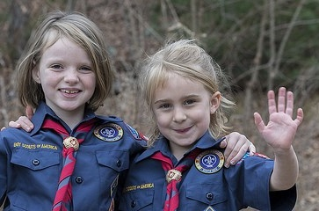
Leveraging Technology
Online meeting rooms (one for each District) along with the software and hardware to use them in remote locations.
“Roundtable meetings” will be retired and replaced with a “Leader’s Forum.” A face to face training and fellowship opportunity that will be live-streamed.
Council Committee meetings and other Council meetings & workshops will also be live-streamed.
Notes:
Narrative:
A new multimedia technology will be implemented to allow meetings to be video, audio and slide presentation capable along with recording for playback. This will allow live audience participation from people attending in-person or those connecting remotely. This newer technology has several benefits in that can reach more people with great content either on the meeting night or at a later time. This change is getting a jump on some of the possible changes the National office is planning to do in the next year or two. (We have had volunteers see and be a part of this planning process) Roundtable will be rebranded as a Leader’s forum and use a planning sheet to focus resources at the correct time.
It should also be the goal of each District to provide a social component to their Leaders Forum depending on the format, times and alternating locations. A leader forum workshop will be held this later summer to help district staff plan for the coming Scouting year.
Jeff Gross

Slide 9
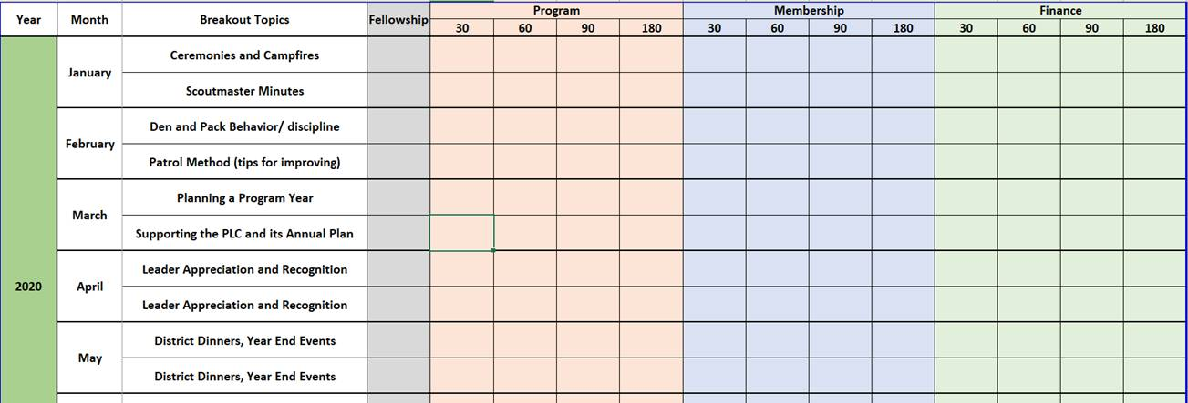
TFC: Monthly Leader’s Forum Planning guide
Notes:
Narrative:
The purpose of the Council-level Master Planning spreadsheet is to give each district’s leader forum staff a tool for a year of planning. Additionally, the template will help drive home the need for COMPLETE District level interaction when it comes to leader forum planning to better communicate across District and Unit Key 3’s and Committees.
Method:
The spreadsheet should be used to better track the full Scouting year as it relates to needed leader forum topics and committee level coordination.
Breakout topics are taken directly from RT guides to provide easily accessible material.
The Committee Communication area is broken down into 30,60,90,180 day sections going from short-term tactical/District focus to long-term strategic/Council.

Slide 10
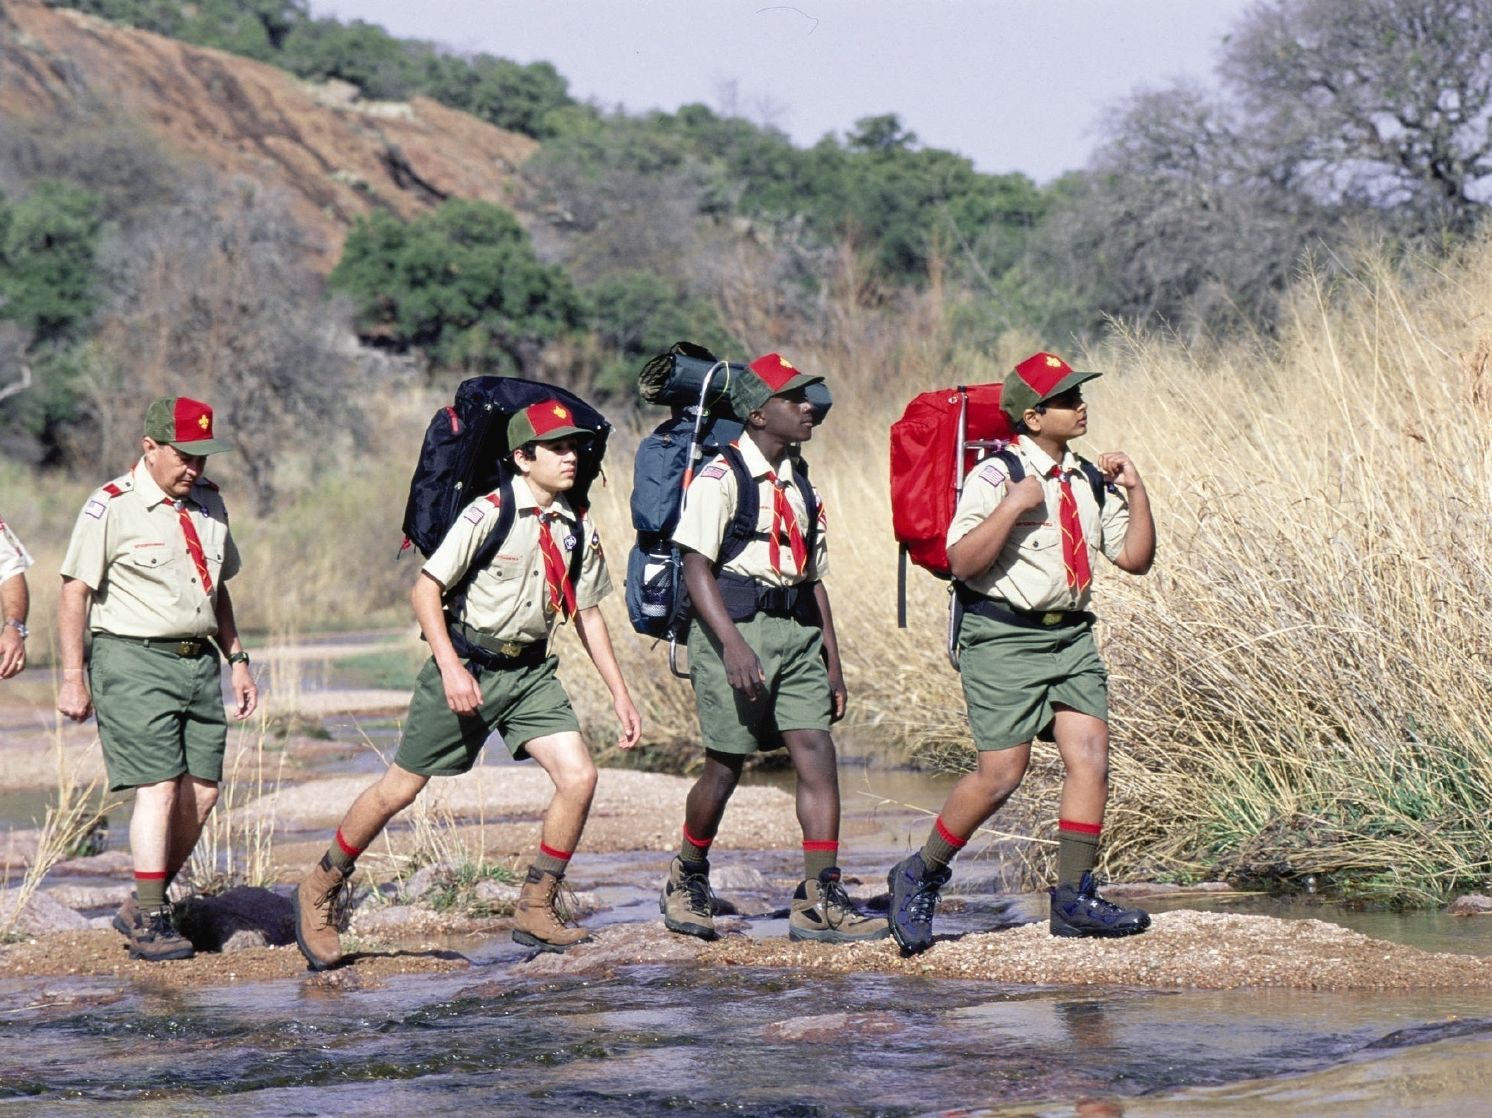
UNIT IMPACT
Better support for membership recruiting at all program levels
Increased support for unit operations
Better support for District Committees in planning and executing programs
Better execution and cultivation of community resources to support local Scouting
Notes:
Narrative:
We plan on this change having a positive impact to all Units, Volunteers and Staff
We will have better trained staff on specific topics such as Membership and Activities
We will have better Committee and Leader Forum meetings with more coverage to all.
We will have better communications to all families on relevant topics.
We will have better activities for unit to participate in.
We will have better membership retention and recruitment due to a better program.
We will have better community support.
Jay Herzog
What does Better look like?
Better means having a subject matter experts for your community on any particular Scouting topic.
Better means having events well planned and executed
Better means having communication delivered to families how and where they must want to receive it
Better means the TFC is attracting and keeping more scouts, families volunteers and donors.
Better means council & district programs are relevant and exciting.

Slide 11
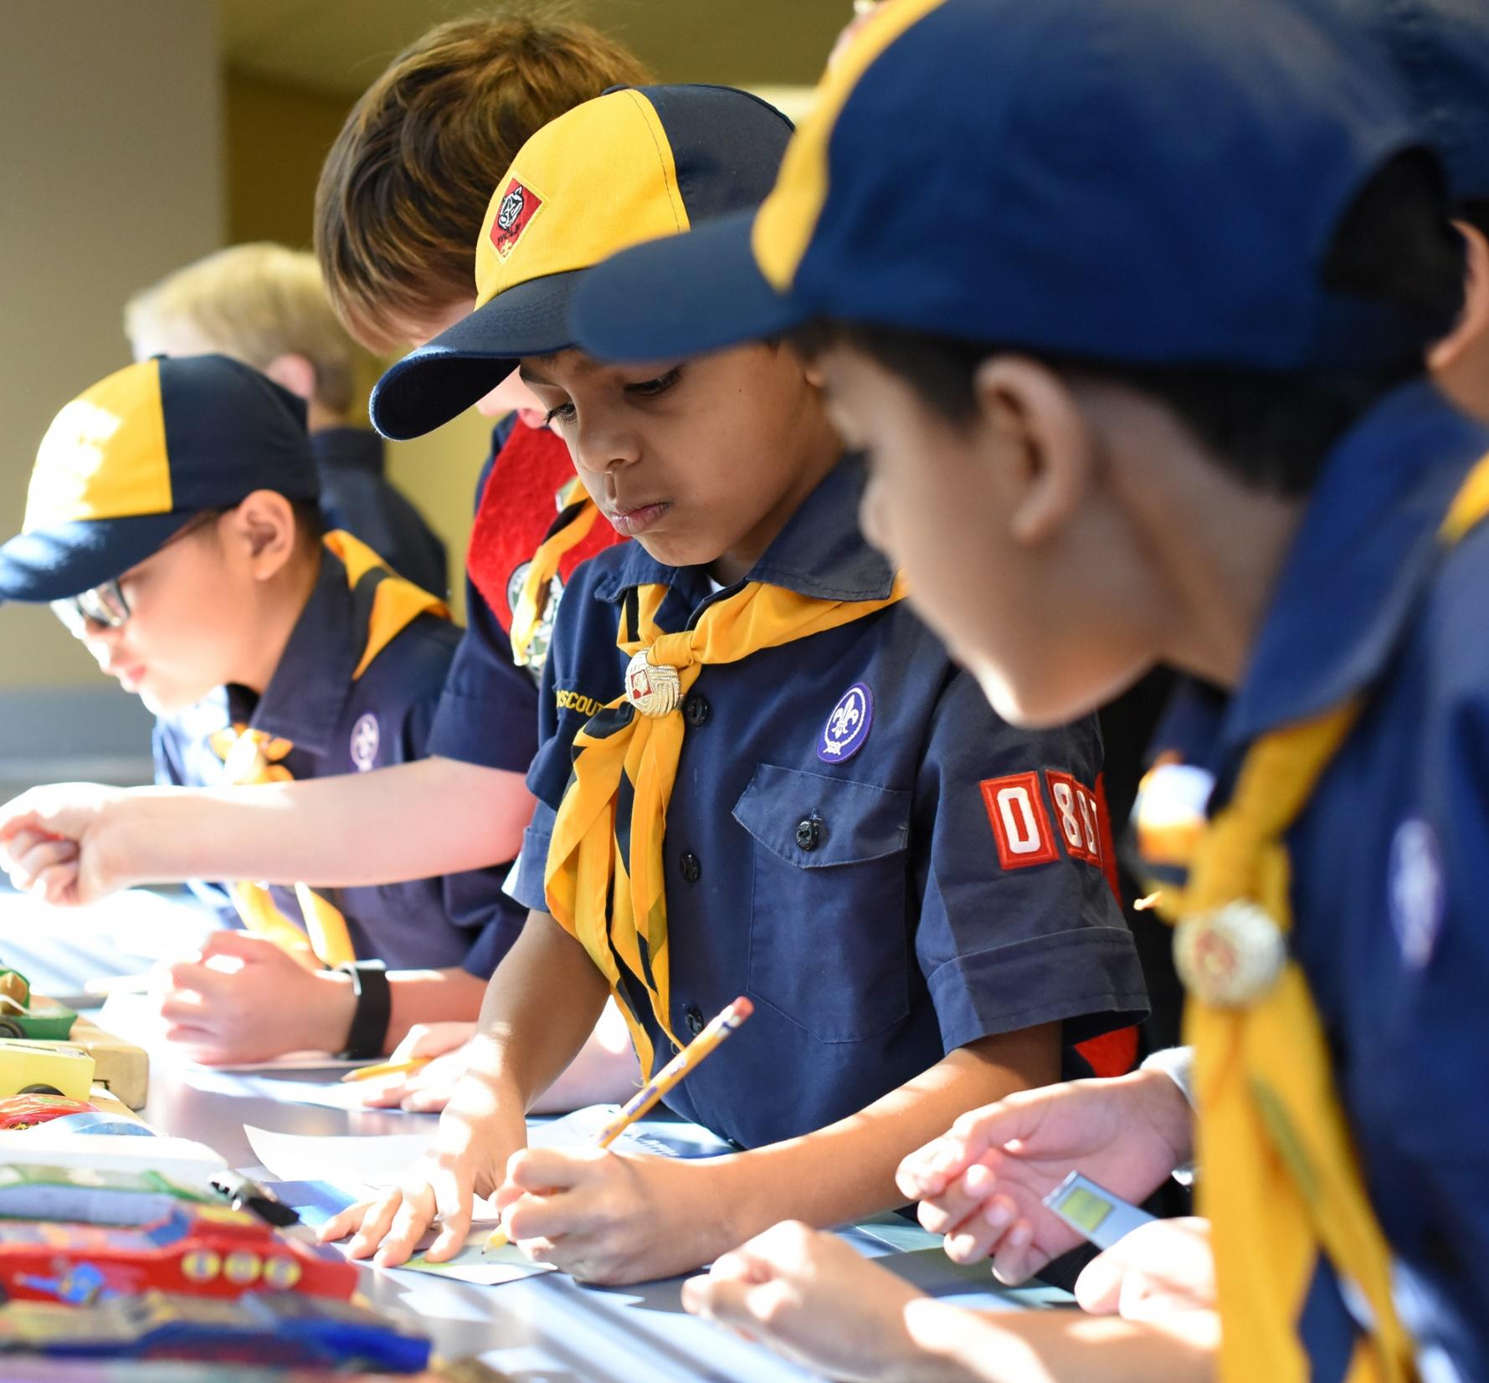
What’s Next How will the new Structure be phased in?
Staffing Alignment
April-June
Volunteer alignment
April-August
Calendar alignment
May-August
Roundtable redevelopment
April-July
Budget building (2020)
August-October
Notes:
Narrative:
The timeline is getting close to complete and we are in the middle of filling up the district committees with the existing and new volunteers. There is a Council Coordinated meeting on Saturday, August 10th and our goal is to have 3 functioning District Committees at this time with Leader Forums scheduled and communicated out to the Units.
Our Professional Staffing alignment is done and can be seen on the TFC website.
The Volunteer positions are being worked on in June and July.
Roundtable to Leader Forum will be launched in August
Calendar and Budget is ongoing from now till October.

Slide 12
Outcomes
After a year of focus groups with steering committees it is believed that these changes will improve…
Volunteer recruiting
Volunteer retention
Council-district-unit-family communication
Staff retention
Membership & Unit growth
Improved district and Council program
Notes:
Narrative:
We see the outcome being better for Volunteers, Staff, Units and the Scouts. We should have better communication, our Staff will be more focused and longer term, our volunteers should have more resources leading to easier recruiting and longer retention which should lead to better programs and membership growth.

Slide 13
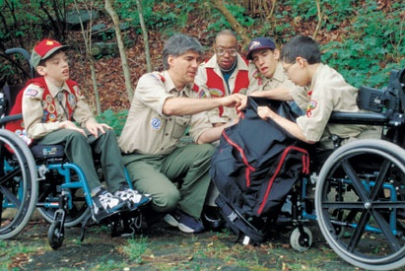
Questions or Concerns
ThreeFiresCouncil.org
For District Committee matters, contact Jeff Gross at Jeff.Gross@3DFamilyTree.com or 630-251-4791.
For District Commisioner matters, contact Anna Touhy at Anna.Touhy@Epsilon.com or 630-555-5555
For Professional Staff matters, contact Clint Scharf at Clint.Scharff@scouting.org or 630-797-4611
Notes:
Narrative:
Thanks for listening and for further information, see the Three Fires Council website or contact one us, Jeff, Anna or Clint.

